Slide 1
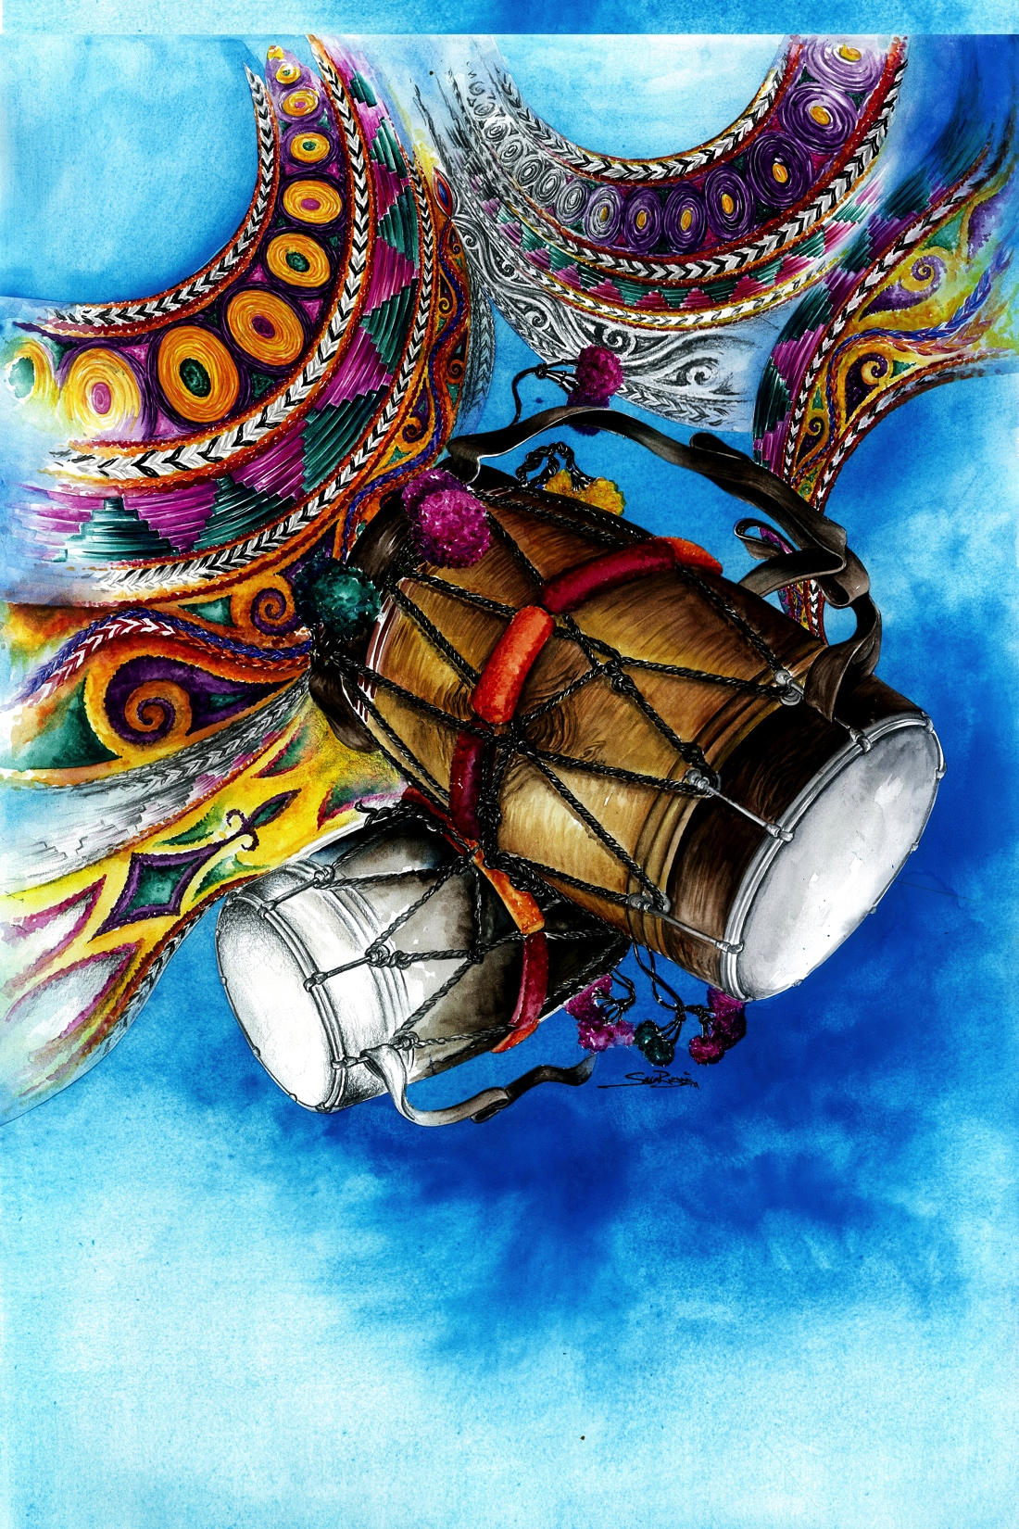
By Hardeep Sahota
When Bhangra Came to Town!

Slide 2
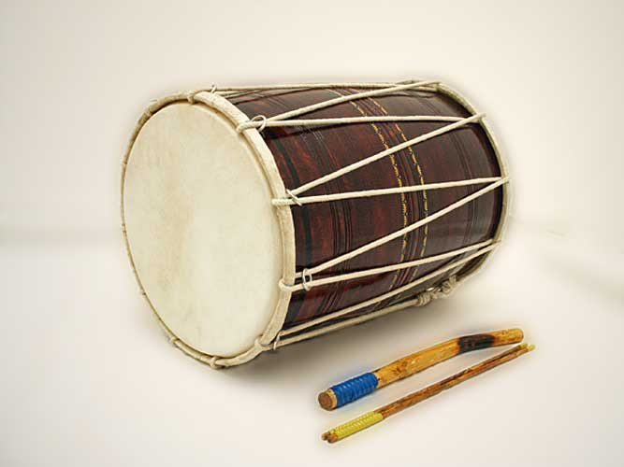
Knowledge Objective:
To learn about Bhangra and how it came to Huddersfield.
Explore the sounds of the main instrument found within Bhangra, the ‘Dhol’ drum.
Skills Objective:
To learn and repeat a simple ‘Chaal’ rhythm.
To play a simple ‘Chaal’ rhythm on a Dhol drum or on the table or even your laps.

Slide 3
Bhangra, originated in the region called Panjab, land of the Five Rivers.

Slide 4
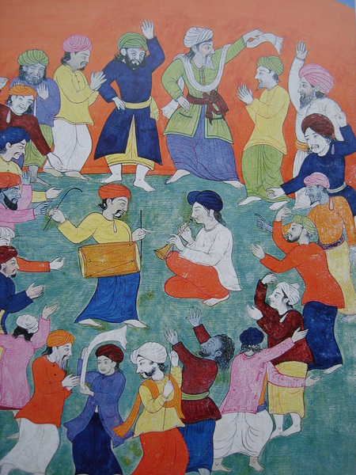
Where do you think is taking place?
What do you think these people are doing?
Why do you think they may be celebrating?
What instruments are being played in this picture?
Notes:
The picture depicts Bhangra being celebrated at the Panjabi harvest festival called Vaisakhi. The ‘dhol’ drummer would normally stand in the middle as the dancers create a circle around him. Bhangra is celebrated by all.

Slide 5
Bhangra’s Journey to Huddersfield
Huddersfield has traditionally been long associated with the textiles industry.
Since the 1950s, it attracted a large influx of migrants from South Asia to fill factory jobs in the rapidly growing industry.
Many of the young men who arrived had not envisaged a permanent stay, however, by the late 1960s most decided to settle, and recognised the UK as their new home.
One special individual, Mohinder Singh, decided to make this decision too. What instrument do you think he brought with him all the way from India to Huddersfield?

Slide 6
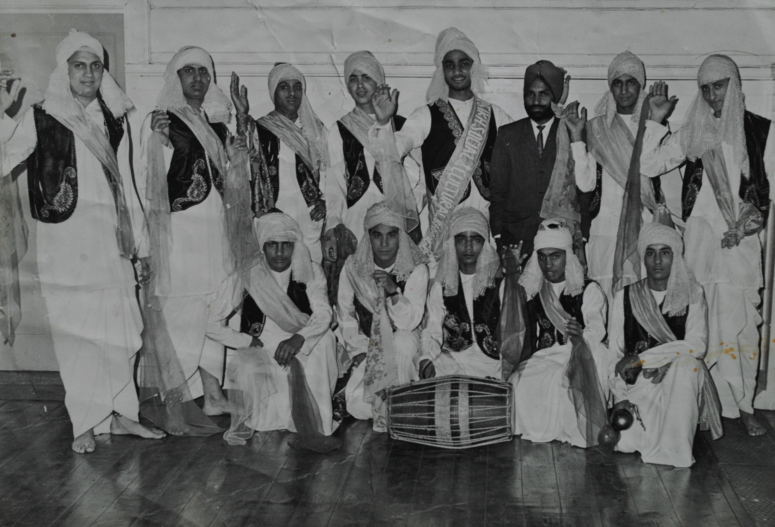
Yes, that’s right, he brought his Dhol drum with him. Mohinder Singh, is seen here dressed in a dark suit along with his newly formed Bhangra Team in 1968.
Notes:
The team’s full name was Huddersfield’s ‘Sikh Social and Cultural Bhangra Group’.

Slide 7
Introduction to the Dhol Drum

Slide 8
The basic ‘Chaal’ beat.

Slide 9
Now over to you, have a go at repeating the Chaal beat and clapping your hands in time with the teacher.
DIN-NA-NA-NA-NA-DA-DIN-NA-
(Repeat)
DIN-NA-NA-NA-NA-DA-DIN-NA-
(Repeat)
DIN-NA-NA-NA-NA-DA-DIN-NA-
(Repeat)

Slide 10
If you don’t have a dhol drum, use other percussion instruments in school school
Try working in pairs, one player maintaining the pulse and the other playing the chaal – keep the pulse regular, just like a heart beat

Slide 11
The basic ‘Chaal’ beat using your hands

Slide 12
The ‘Chaal’ beat on a Dhol Drum

Slide 13
Using a range of Dhol Beats.

Slide 14
Plenary: What have you learnt from today? Today you have learnt how Bhangra came to Town, and the ‘Chaal’ beat on the Dhol drum.

Slide 15
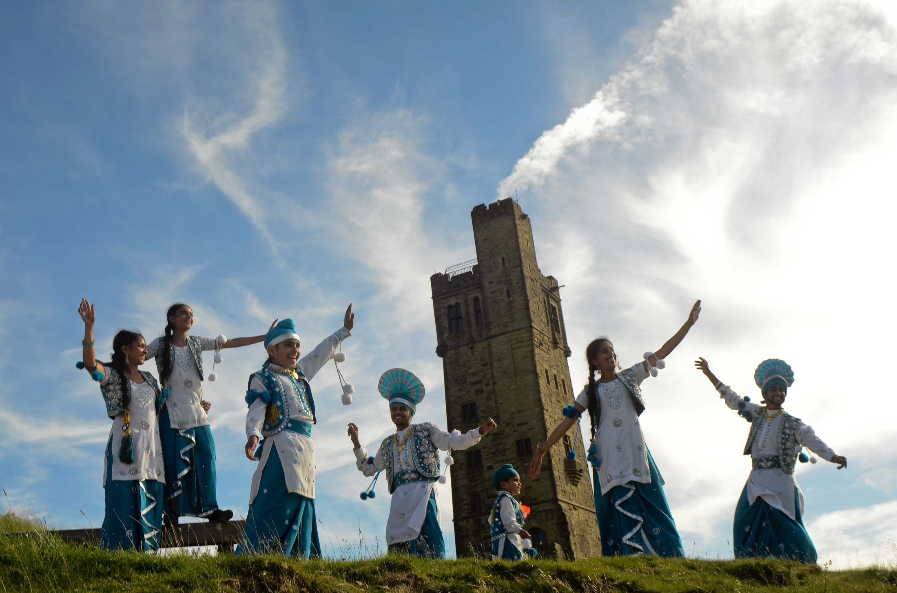
If you would like to learn more about Bhangra or the Dhol drum, you can explore the book, Bhangra: Mystics, Music & Migration or Take part in classes led by Hardeep Sahota and his Bhangra team ‘VIRSA’. Photography and videography by Tim Smith for Cultural connections project

